Slide 1

Athletics
Parent Meeting
COVID-19 PROTOCOLS
SPORTS MEDICINE & PERFORMANCE
SEPTEMBER 11, 2020

Slide 2


Sports Medicine
General COVID-19 considerations → “M3D”
Masking - must wear an acceptable face covering at all times
In all common areas, AT Facilities & when riding in College vans
During strength & conditioning workouts indoors
Bandanas, buffs and gaiters are NOT acceptable face coverings
Distancing - 6-feet in general; 12-feet during physical activities
Density management - each space / venue has capacity limitations - Respect to Protect!
Disinfecting / sanitizing
Wash / sanitize hands prior to and after any drill and after touching your face, mouth, nose or eyes
Disinfect spaces, electronic equipment, sports equipment BEFORE and AFTER use

Slide 3
Sports Medicine
AT Staffing model
Team designated AT → AT may work shifts rather than be at their “team” sessions
Michelle Copolo-Ziemer → Cross Country / Track, W.Volleyball, Triathlon
Karen Roehling → Bowling, W.Basketball, W.Soccer, M.Tennis
Zach Morris → M.Soccer, M.Volleyball, W.Tennis
Jeff Sage → Cheerleading, M.Basketball
Virtual “office hours” and designaged treatment hours for each AT
Adhere to the appointment procedures
Unless it’s an emergency, you may be turned away if just dropping by

Slide 4
Sports Medicine
Daily Screening for CARA or treatment
All student-athletes will use SportsWareOnLine (SWOL) for logging their daily health screening prior to engaging in any CARA.
SAs can take their own temp or thermometers will be available at either the Lumsden or AWC venues to use prior to engaging in CARA.
Individual sport coaches will be issued a thermometer.
Temperatures should be taken by all prior to getting on any van / bus.
Anyone that is symptomatic will be sent “home” and notify the AT Staff.

Slide 5
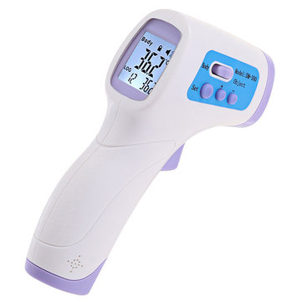
Sports Medicine
Daily COVID screening
Within the last 14-days, have had any of the following:
Fever of 100.4F or higher
Symptoms
Exposure → close contact with a known positive COVID case
Within 6 feet for more than 15 minutes without proper PPE
Same sleeping area (maybe same living area, depending on circumstance)
Occur within 48-hr prior to symptom-onset or positive test collection date
Travel - Daemen policy=mandatory 14-day quarantine upon returning to NYS
Positive COVID test

Slide 6
Sports Medicine
Student-Athlete “Call-in Sick” Protocol
We will defer to institutional and predetermined Team MD protocols on action
Coach and SA should be contacting AT → AT will connect virtually with SA
Cases not related to a positive COVID test:
Assess onset, symptoms, SA medical & COVID history, etc
Decision case-by-case
May need to stay home x1, 2, 3+ days to monitor symptoms (esp. if feverish)
May or may not be sent for COVID testing

Slide 7
Sports Medicine
Daemen COVID-positive Protocol
Cases involving a positive COVID test:
AT will notify Admin-On-Call and submit a CARE report
Isolation x10 days from onset of symptoms or from test date (if asymptomatic)
On-campus residents may be relocated temporarily to hotel
Precautionary quarantine x14 days for any “close contacts”
Impact: Coaches, AT staff, players in same “pod”, roommates, family, etc
May need cardiac work up after completing isolation period
Return-to-play progression dependent upon severity of case
Must be cleared to return to classes before starting RTP process

Slide 8
Sports Medicine
Health Insurance
Required for all student-athletes to participate → primary
Athletics has an excess insurance policy → secondary
Secondary insurance is an “accident” policy, not “sickness” policy
As per NCAA guidelines, Athletics will cover any athletic-related COVID expense (e.g. testing and or treatment) if denied by primary insurance
As for any other injury, we will proceed with facilitating secondary insurance by initiating the claims process.

Slide 9
Sports Medicine
Resocialization period = 6 weeks → NO CONTACT
Week 1 = 50%
Week 2 = 70%
Week 3 = 80%
Week 4 = 90%
Week 5 = 90-100%
Week 6 = 100%
Weeks 1-2 → individual skill focus; no sharing of equipment
Weeks 3-4 → partner drills; partner groups may share equipment
Weeks 5-6 → small group (“pod”) drills; “pod” members may share equipment

Slide 10
Sports Medicine
Daemen COVID testing
Initial testing → every employee and student was tested prior to or upon arrival to campus
Surveillance testing
Systematic testing scheme to monitor infection rate of a group
Help control outbreaks or “clusters”
Damen COVID surveillance testing will begin on Mon 9/14
If you have received an email to sign up → MAKE an appointment → This is required!
Disciplinary action may be taken for on-campus residents
Student-athletes → participation will be restricted until compliant
Athletics may do concurrent NCAA surveillance testing

Slide 11
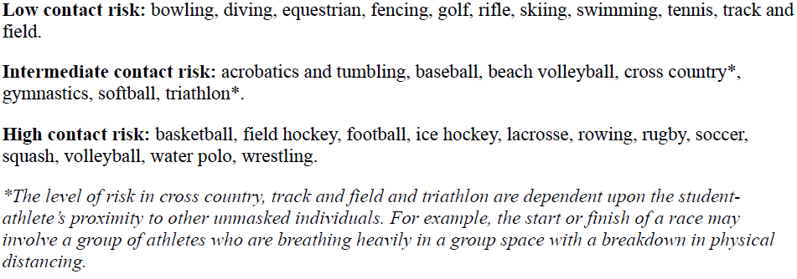
Sports Medicine
NCAA Surveillance testing

Slide 12
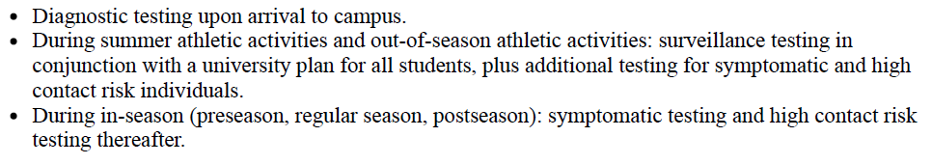
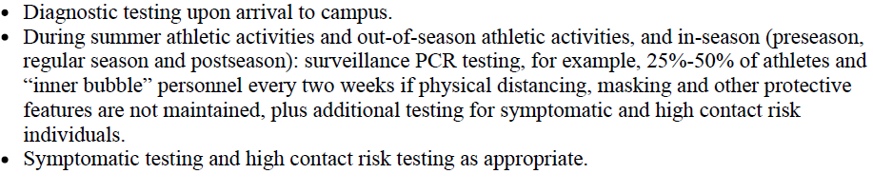
Sports Medicine
NCAA Surveillance testing for Low contact risk sports:
Intermediate contact risk sports:

Slide 13
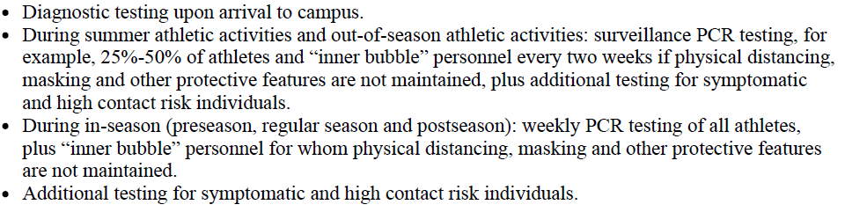
Sports Medicine
NCAA Surveillance testing for High contact risk sports:
NCAA Pre-competition testing for High contact risk sports:

Slide 14
Sports Performance
Strength & Conditioning Workouts
Must complete the SportsWareOnLine (SWOL) COVID health screening prior to workout
Your account should be set up during your medical check-in
Must wear an acceptable face covering at all times when workout indoors
Masks may be taken down when workout outdoors with 12-feet distancing
Bandanas, buffs and gaiters are NOT acceptable face coverings
[At least] for the month of September:
Weather permitting, workout sessions will held outside on the AWC Lawn
AWC gym will be used if we can’t be outside
Once weather starts to turn...things will move indoors to AWC Fitness Center or Gym.
Awaiting new TRX & Kettlebells to better facilitate workouts in the AWC gym utilizing that equipment and bands

Slide 15
Sports Performance
Strength & Conditioning Workouts
Sessions will be 1 hour long, 15-30 minute break in between sessions for cleaning/disinfection of equipment
S&C schedule will be dependent upon practice and class schedules
Student Athletes will be asked to stay and help clean/disinfect equipment if they do not have to go to class immediately following lift
TrainHeroic
Strength & conditioning electronic platform → all student-athletes will be given access
Workouts will be posted on this system
To get other “training” days in on their own
To make up a missed session
They will have to sign up for a time slot, just like any other person utilizing the facility

